Slide 1
Scaling SharePoint: Meeting the Demands of Exponential Growth
Emily Mancini
Derek Cash-Peterson

Slide 2





Emily Mancini
Architect
Information Architect, Customer Experience Evangelist, & UX Specialist
Formerly an Office 365 Platform Owner and Trainer
emilymancini.com
linkedin.com/in/eemancini
@eemancini

Slide 3


Derek Cash-Peterson
Principal Architect
Professional developer since 1999
Working with SharePoint since 2006
https://spdcp.com
linkedin.com/in/derek-cash-peterson-6320752 ​
@spdcp
https://github.com/dcashpeterson/Public-Samples

Slide 4


Slide 5
Agenda
Generate demand
Identify toe hold
Customer experience
Inclusive environment
Manage demand
Governance
Self-Service
Align with business
Scale demand
Steering Committee
Strategic Plan

Slide 6


Slide 7
Generate demand by focusing on:
Which tools are best for the organization
Integration in Office 365
Productivity training

Slide 8


Slide 9
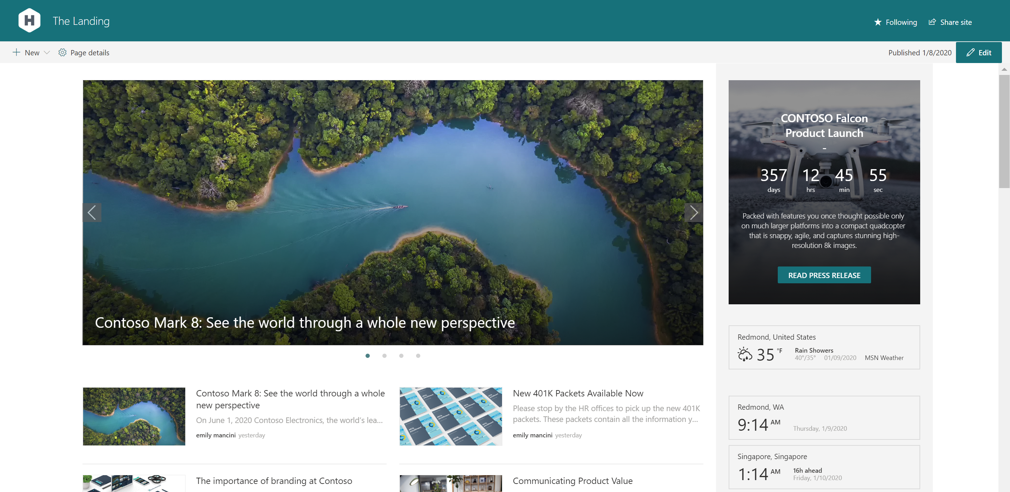
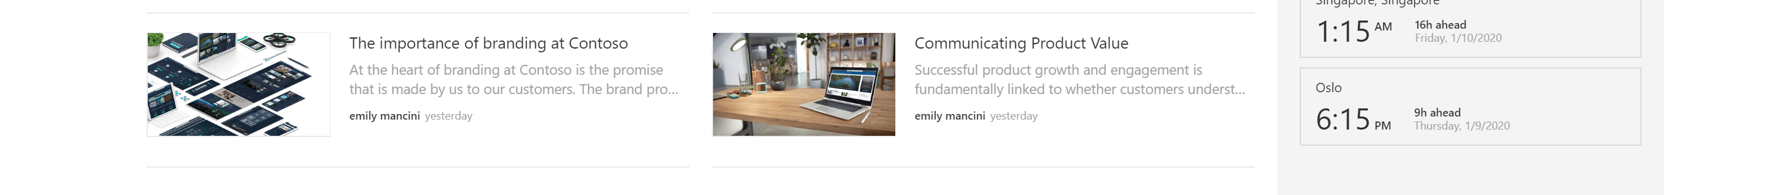

Slide 10
Creating a personalized experience by focusing on:
Generating buzz
Branding
Individualized content
Localization

Slide 11


Slide 12


Slide 13

SharePoint Coauthoring Error Customer Journey
Navigate to SharePoint Site | Open document and begin editing | Encounter error | Navigate to ticket system | Input ticket | Coordinate time to troubleshoot | Meet to troubleshoot | Ticket closure
Baseline
Touchpoints

Slide 14
SharePoint Coauthoring Error
Service Map
Time | 2-5 minutes | 2 hours | 5 minutes | 3 minutes | 6 minutes | 3 days | 30 minutes
Evidence |  |  | Error message; screenshot |  | Ticket # |  |  | Ticket notes
Customer Journey | Navigate to SharePoint Site | Opens document and begin editing | Encounters error | Navigate to ticket system | Input ticket | Coordinate time to troubleshoot | Meet to troubleshoot | Ticket closure email
Frontstage Actions |  |  |  |  |  |  | Virtual meeting | Closes ticket
Backstage Actions
Support Processes
Line of Interaction
Line of Visibility
Ticket Queue
Line of Internal Interaction
Site Analytics
Word Processing Software
Single Sign On
IT Service Management
External support
Virtual Conference
Email

Slide 15
Create a seamless customer experience by focusing on:
Consistency across touchpoints
Building relationships

Slide 16
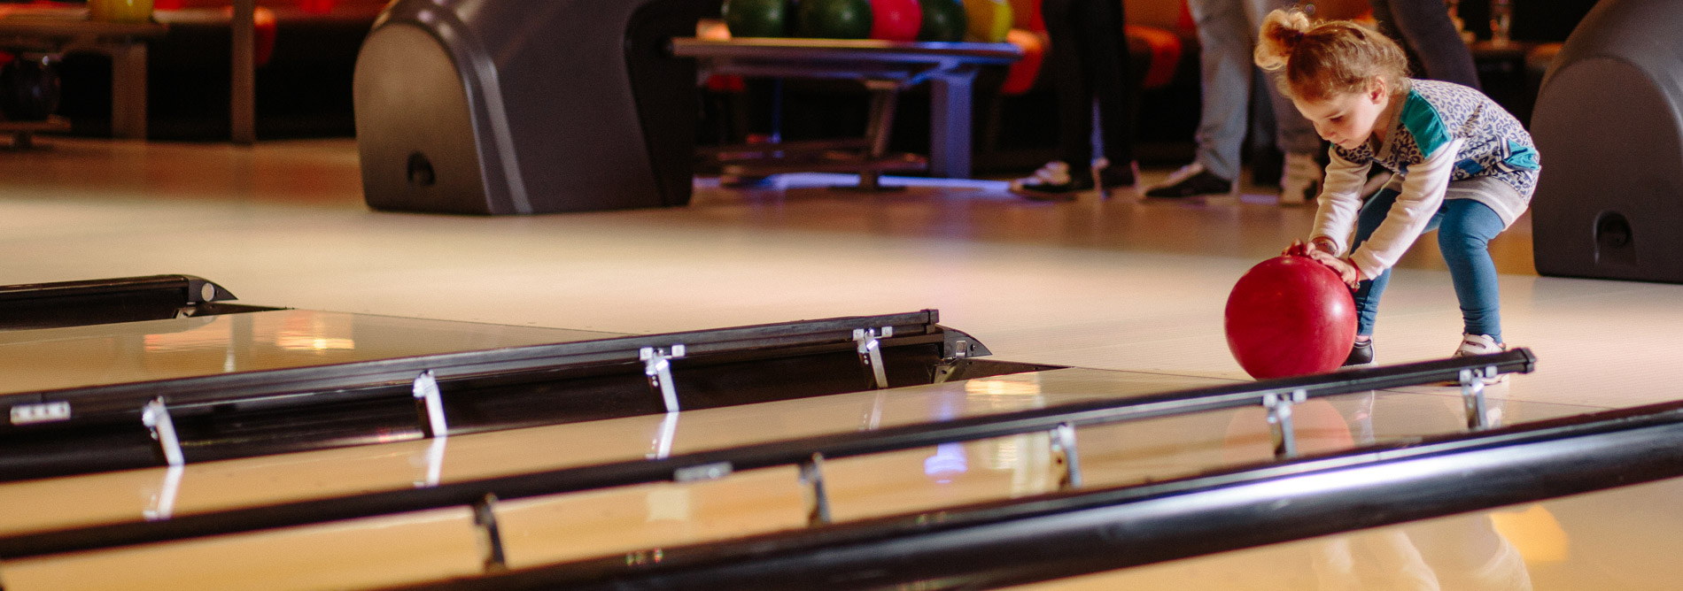

Slide 17
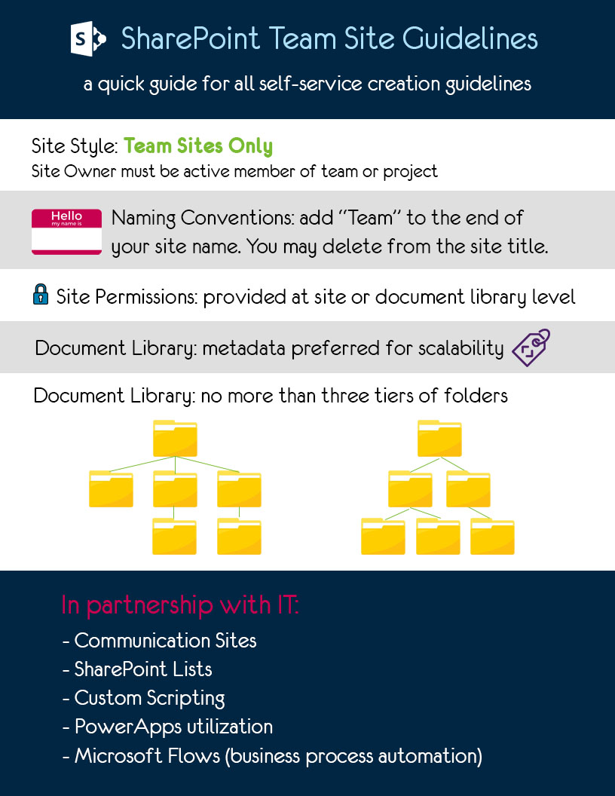

Slide 18
Audit Type​ | Purpose​ | Cadence​
New Team Site & Communication Site Creation​ | -Ensure Team Site creators have gone through required training​ -Reduce duplication of sites in environment​ -Ensure Communication Sites are built in partnership with IT​ | Daily​
Subsite Creation​ | -Ensure best practices are being followed to utilize hub sites; not subsites​ | Daily​
Public Team Sites | -Ensure team sites aren’t used as communication sites​ | Monthly​
Sites Without Owners​ | -Ensure consistent business ownership of content​ | Quarterly​
External Users without Activity in Past 90 days​ | -Ensure external access is removed for discontinued relationships​ | Quarterly​
Team Sites without Activity in Past 90 Days​ | -Ensure all sites in our environment are in actively in use​ | Quarterly​
Sites with Broken Links​ | -Ensure accuracy of data in our sites​ | Quarterly​

Slide 19
Create a governance plan by focusing on:
Asking lots of questions first
Socializing governance with site owners
Implementing auditing

Slide 20
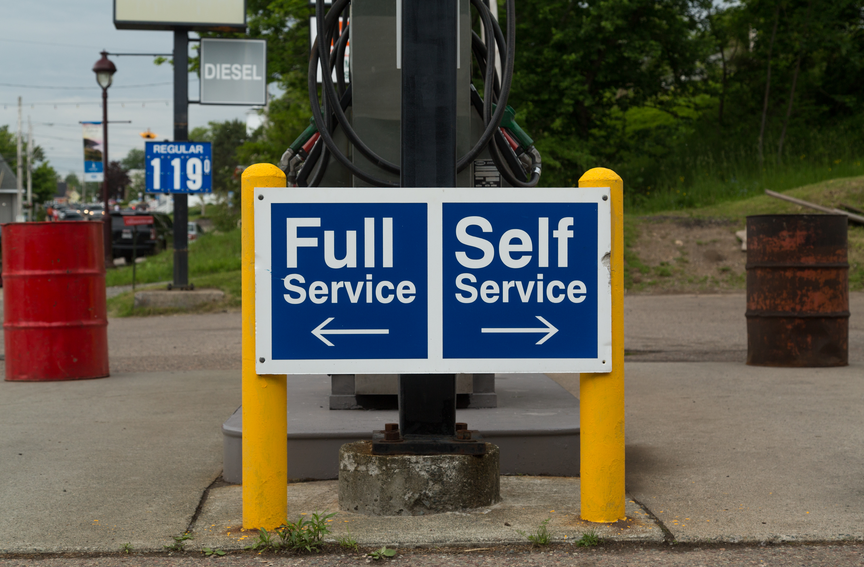

Slide 21
Roles & Responsibilities
Role | Responsibilities
SharePoint Admin | Guide information architecture, security, and governance of environment Assist in more complicated web part, app, and business process automation creation Support Site Owners & Members to fly solo
Site Owner | Attend Site Owner training every 18 months Monitor content Provide access to new employees Guide Site Members on best practices and proper site usage for your team Provide support in consistent tone, look, and feel for content Report issues with site via ServiceNow tickets
Site Member | Follow best practices and proper site usage for your team Actively engage with site Report issues via ServiceNow tickets

Slide 22

Site designs as governance support providing consistent:
Site set up
Site columns & content types
Navigation
Theming

Slide 23


Slide 24
Launch self-service by focusing on:
Identifying champions
Partnering in site development
Today 11:20 AM – 12:30 PM
SharePoint Site Designs: Vision and Reality Marc Anderson
Creating long-term support

Slide 25


Slide 26
Support self-service by focusing on:
Aligning goals with the business
Communicating expectations to leaders
Celebrating Site Owners’ successes

Slide 27


Slide 28
Establish a steering committee by focusing on:
Increasing visibility into Office 365 metrics and project queue
Aligning Office 365 needs with business and culture goals
Highlighting risk of keeping status quo

Slide 29
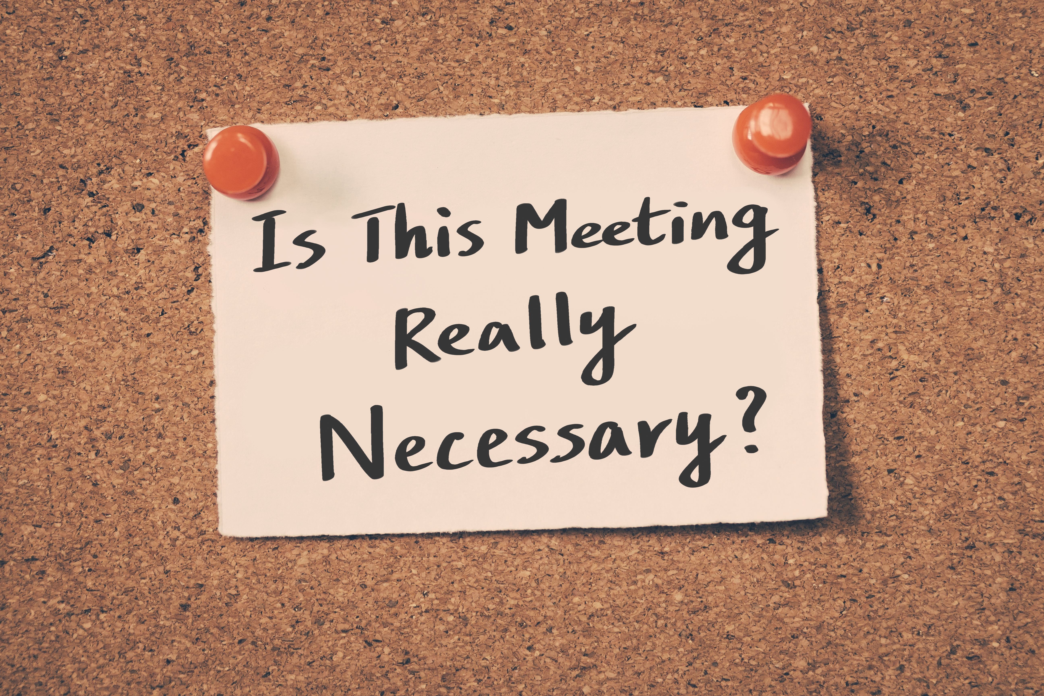

Slide 30
Run an effective steering committee by focusing on:
Routine project prioritization & communication
Align requests with company goals
Create visibility for company into project queue

Slide 31


Slide 32
Establish a strategic plan by focusing on:
Department-level goals
Enterprise-level solutions
Transparency

Slide 33
Time for Q&A…

Slide 34
Resources
Sessions Today:
11:20 AM – 12:30 PM- SharePoint Site Designs: Vision and Reality, Marc Anderson
Online Resources:
Nielsen Normal Group Articles: on Customer Experience and Organizational Fluidity:
Good Customer Experience Demands Organizational Fluidity
User Experience vs. Customer Experience: What's the Difference?
SharePoint Site Design and Site Script Overview
Sue Hanley’s SharePoint and Office 365 Governance Policies and Guidelines Questions

Slide 35
THANK YOU!

